Slide 1
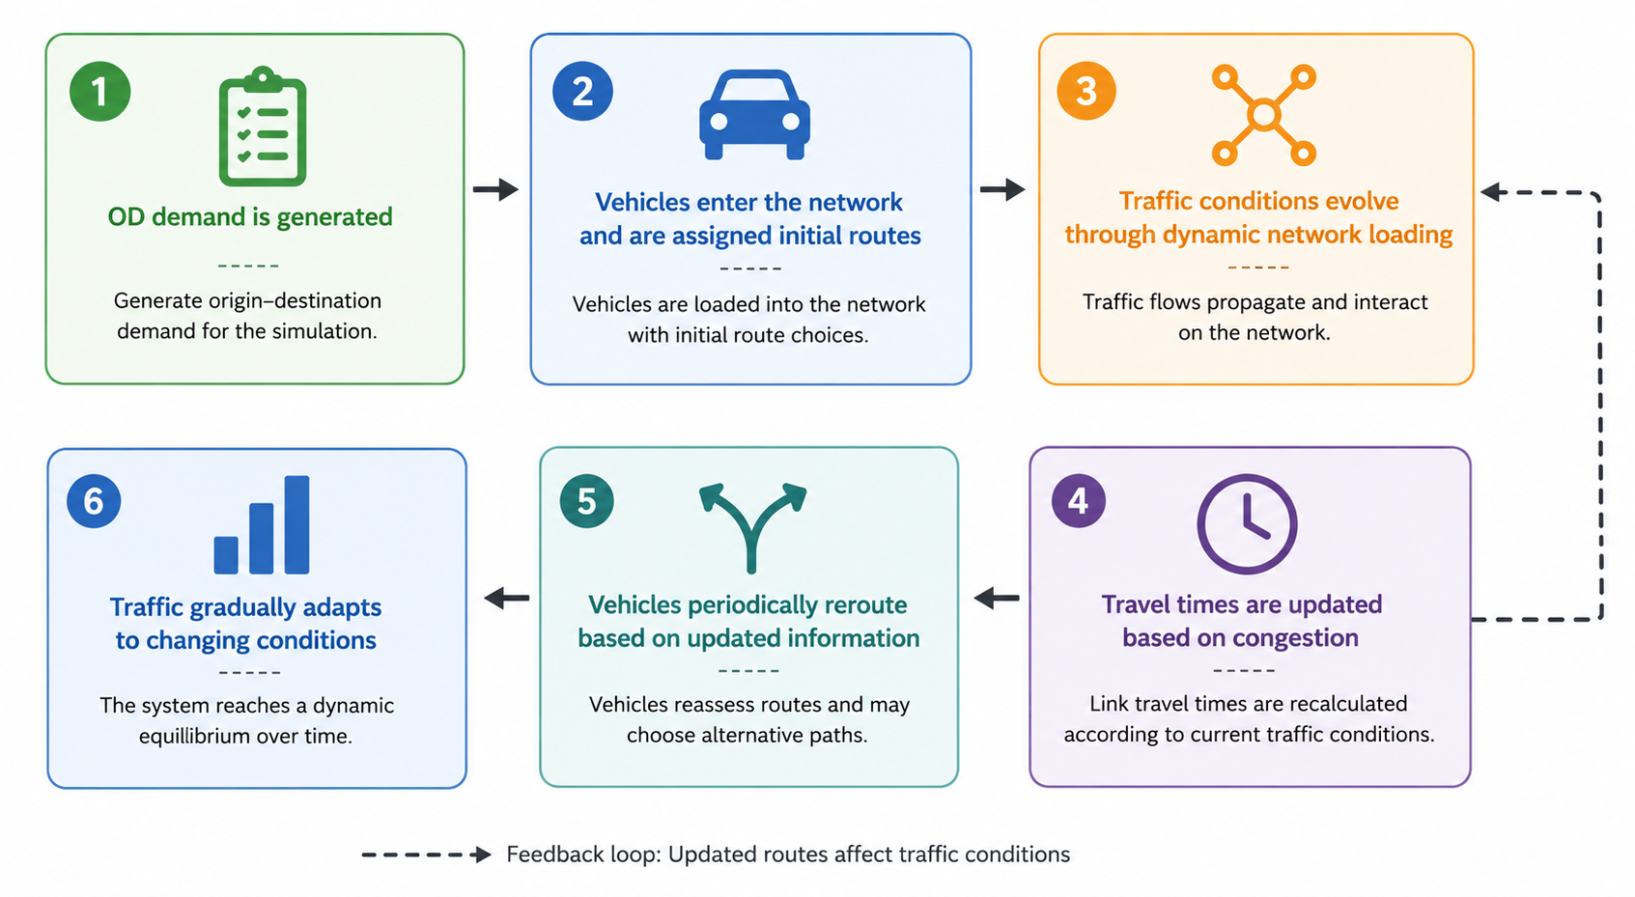

Process Flow
Feedback Loop: Updated routes affect traffic conditions
Notes:
\begin{itemize}\item OD demand is generated;\item Vehicles enter the network and are assigned initial routes;\item Traffic conditions evolve through dynamic network loading;\item Travel times are updated based on congestion;\item Vehicles periodically reroute based on updated information;\item Traffic gradually adapts to changing conditions.\end{itemize}

Slide 3
Initial OD matrix
Step1
SUMO simulation
OD pairs
Generate Trips
Step2
Assign Trips
Simulated detector data
Optimization algorithm
Step3
Evaluate reality gap
Update OD matrix

